Slide 1
Communication Technologies 2 (CT2) Machine Learning: Applications and Algorithms Recognition of stress and no stress with Gaussian Mixture Models (GMM) and k-Means Algorithm
Youssef Ahmed Rawy Baghdady, Ebraam Khalifa
Akshesh Chavda, Akcanchha Choudhary
Lecture in WS 2018 / 2019 25/03/2019

Slide 2
Contents
Motivation
Process of Measurement for initial state and stress state
Methodology of recognition
Evaluation of recognition
Notes:
Present this slide only if you have time

Slide 3

Motivation.
In today’s world stress is the most important health factor to be recognized in human beings.
It comes with many hidden health problems in human life.
Important to find out the most reliable and spontaneous method or technology to perform this task.
Fig. 1 Brain Strom of Stress [1]

Slide 4
Process of Measurement
Cold pressor test (CPT) method
Physical and mental factors which can influence measurements are,
Emotions
Health
Noise
Confidence level
Ambient Temperature
Workload(mental condition)
Performing sport etc.
Notes:
Explain CPT (no text needed)

Slide 5
Process of Measurement
The measurement session was performed as follow,
Rest (15 minutes)
Normal reading (3 minutes)
Task explaination
Submerging hand (max. 3 minutes)
Rest (1 minute)
Number of participants : 4
Cold water temperature : near to 0⁰C
Ambient temperature : 25⁰C
Notes:
This slide is good! Add the one participant of the previous slide and this slide will be perfect!

Slide 6
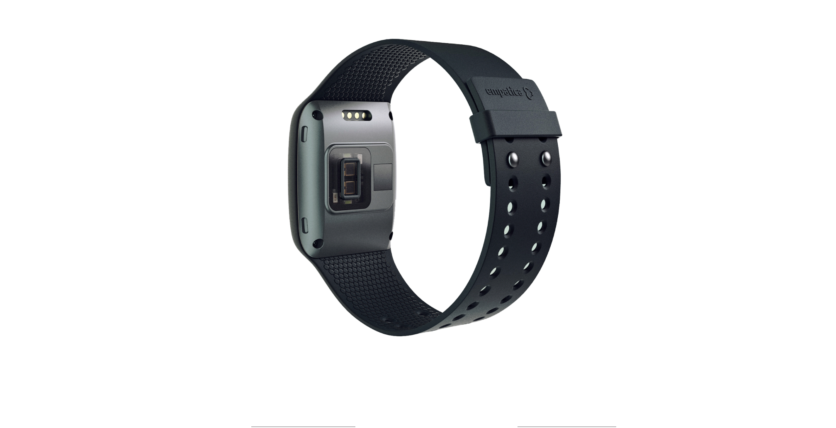
Process of Measurement
Wearable research device
Offers real time physiological data acquisition
Software for in-depth analysis and visualisation
Sensors
PPG sensor : Measures Blood Volume Pulse(BVP)
EDA sensor : Measure fluctuations in electrical properties of skin
Infrared Thermopile : Reads peripheral skin temperature
3-axis Accelerometer : Captures motion based activity
Fig. 2 E4 Empatica [7]
Notes:
Delete this slide and mention water temperature and test measurement in the next slide!

Slide 7
Methodology of recognition
Methodology of recognition has following process,
GMM algorithm.
K-Means algorithm.
Methodology for evaluation
Notes:
Point 4 unclear
Bring this slide

Slide 8
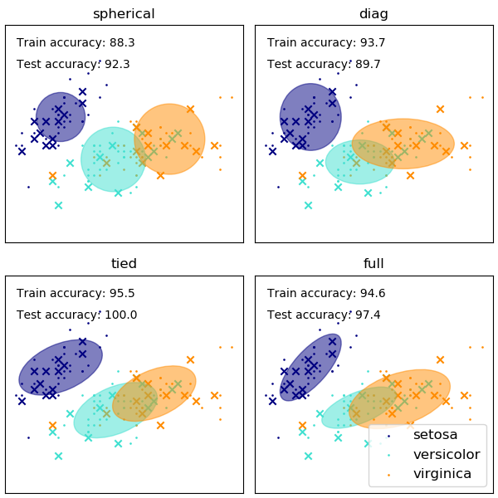
Methodology of recognition
A brief introduction
A Gaussian mixture model (GMM) can be defined as a probabilistic model.
K-means clustering to assimilate information about the covariance structure of the information collected.
Fit the mixture of Gaussian models
Fig. 3 GMM with different classes [2]
Notes:
Motaivation before Introduction!
Reference missing! -> figure 1
No bring it directly to methodology

Slide 9
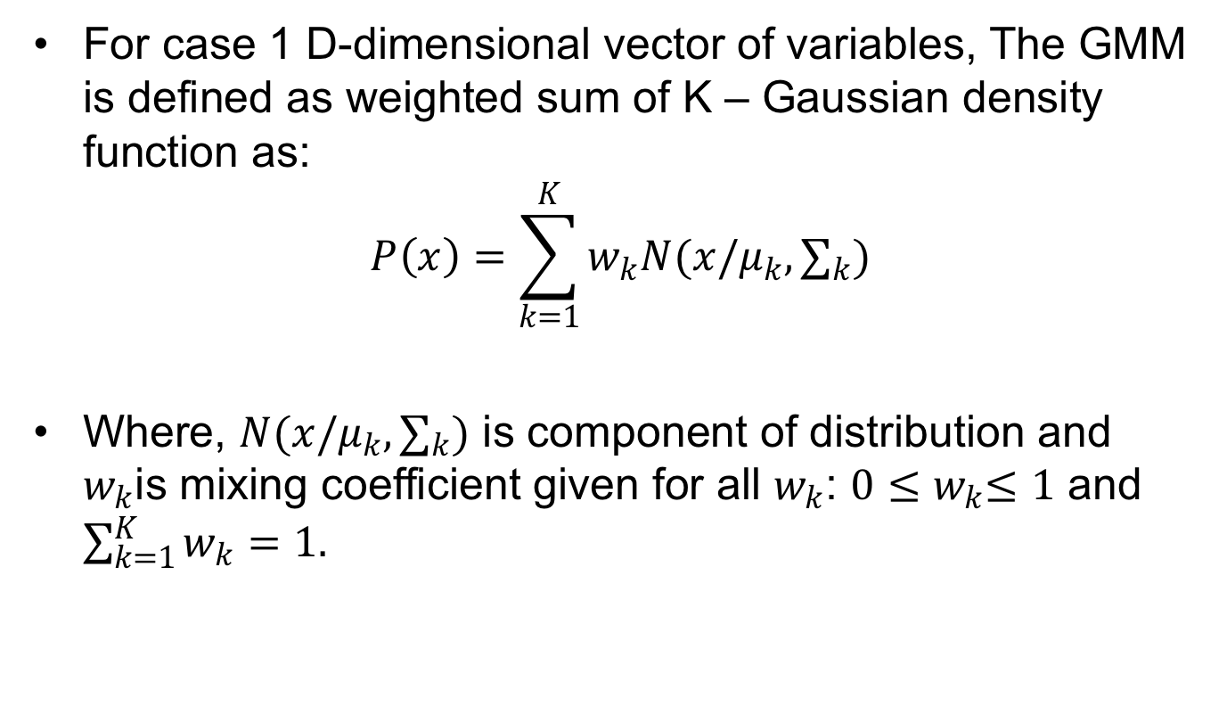
Methodology of recognition
For case 1 D-dimensional vector of variables, The GMM is defined as weighted sum of K – Gaussian density function as:
$$P\left(x\right)=\sum_{k=1}^{K}{w_{k}N(x/μ_{k},}∑_{k})$$
Where, $N(x/μ_{k},∑_{k})$ is component of distribution and $w_{k}$is mixing coefficient given for all $w_{k}$: $0{≤w}_{k}≤1$ and $\sum_{k=1}^{K}{w_{k}=1.}$
Notes:
Please try to find all spelling mistakes and grammar mistakes in all of your slides!!!!
Methodology

Slide 10
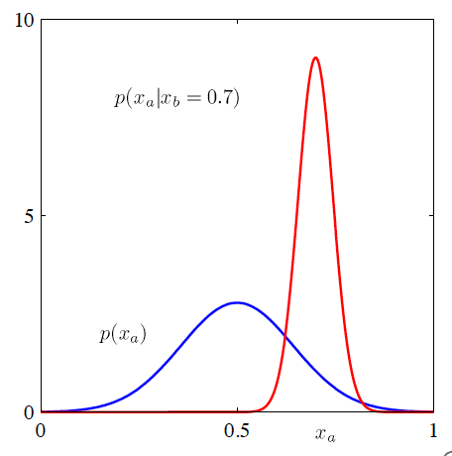
Methodology of recognition
Fig. 4 GMM 1-Dimensional [3]
Notes:
Reference missing
Dont show this figures!
Use the example of bishop
Methodology part!

Slide 11
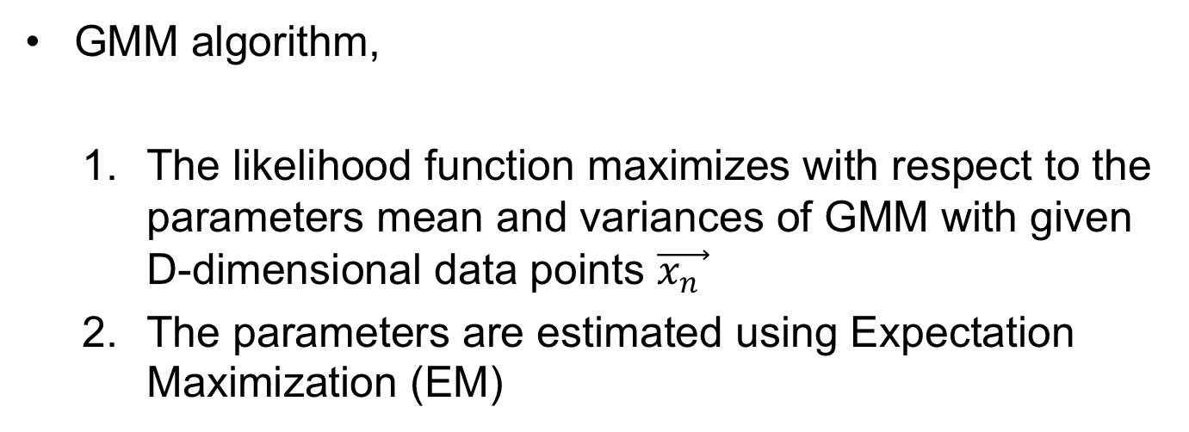
Methodology of recognition
GMM algorithm,
The likelihood function maximizes with respect to the parameters mean and variances of GMM with given D-dimensional data points $\vec{x_{n} }$
The parameters are estimated using Expectation Maximization (EM)
Notes:
And again....GMM
Bring all GMM to one part of your presentation!

Slide 12
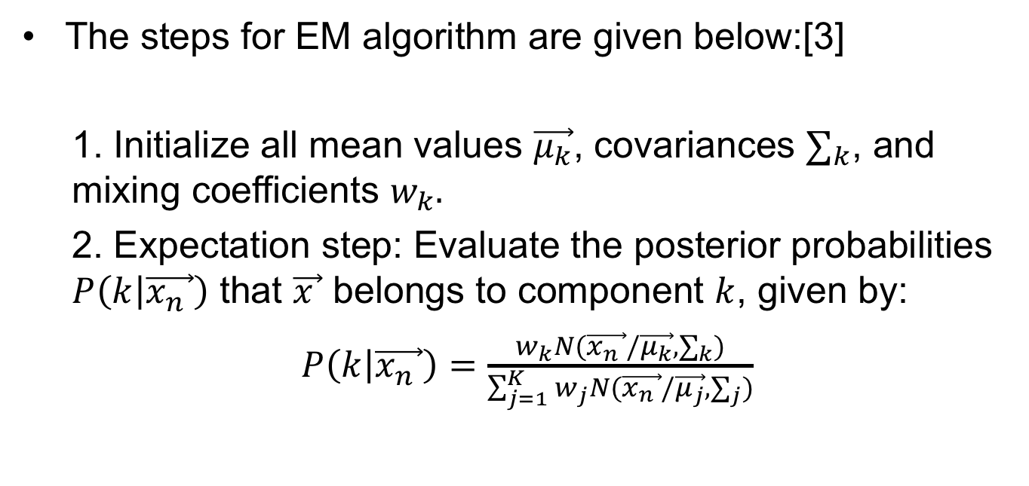
Methodology of recognition
The steps for EM algorithm are given below:[3]
1. Initialize all mean values $\vec{μ_{k}}$, covariances $∑_{k}$, and mixing coefficients $w_{k}.$
2. Expectation step: Evaluate the posterior probabilities $P\left(k | \vec{x_{n} }\right)$ that $\vec{x }$ belongs to component $k$, given by:
$P\left(k | \vec{x_{n} }\right)=\frac{w_{k}N(\vec{x_{n} }/\vec{μ_{k}}, ∑_{k})}{\sum_{j=1}^{K}{w_{j}N(}\vec{x_{n} }/\vec{μ_{j}}, ∑_{j})}$

Slide 13
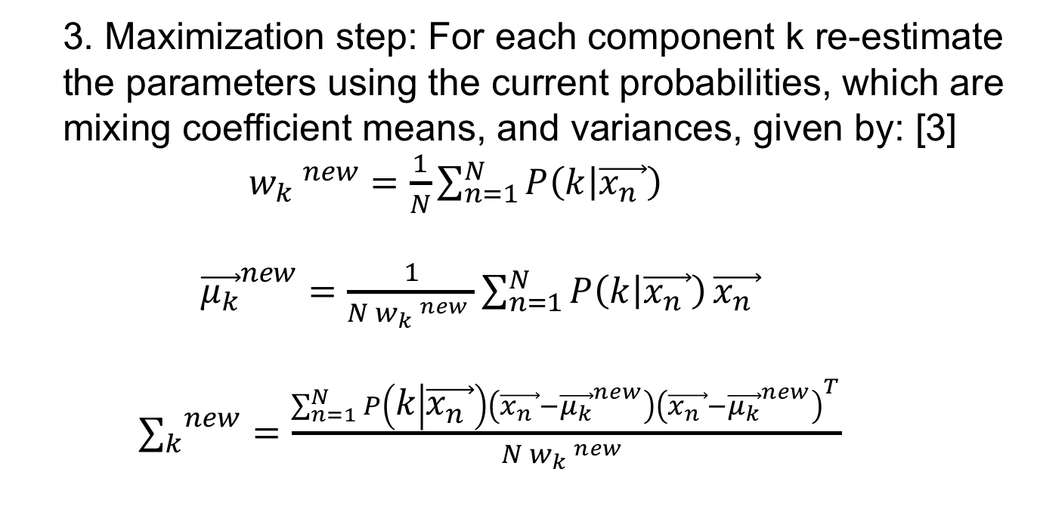
Methodology of recognition
3. Maximization step: For each component k re-estimate the parameters using the current probabilities, which are mixing coefficient means, and variances, given by: [3]
${{ w}_{k} }^{new}=\frac{1}{N}\sum_{n=1}^{N}{P\left(k | \vec{x_{n} }\right)}$
${\vec{μ_{k}}}^{new}=\frac{1}{N {w_{k} }^{new} }\sum_{n=1}^{N}{P\left(k | \vec{x_{n} }\right)}\vec{x_{n} }$
${∑_{k}}^{new}=\frac{\sum_{n=1}^{N}{P\left(k | \vec{x_{n} }\right)}\left(\vec{x_{n} }−{\vec{μ_{k}}}^{new}\right){\left(\vec{x_{n} }−{\vec{μ_{k}}}^{new}\right)}^{T}}{N {w_{k} }^{new} }$

Slide 14
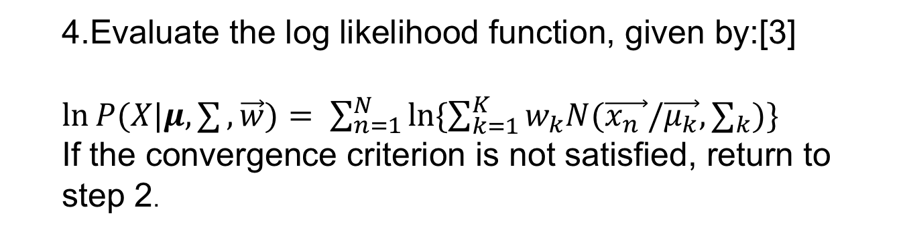
Methodology of recognition
4.Evaluate the log likelihood function, given by:[3]
$\ln{P(X|μ,∑},\vec{w})= \sum_{n=1}^{N}{\ln{\{\sum_{k=1}^{K}{w_{k}N(\vec{x_{n} }/\vec{μ_{k}},}∑_{k})\}}}$
If the convergence criterion is not satisfied, return to step 2.

Slide 15
Methodology of recognition
K-Means algorithm is deterministic clustering algorithms that aims to dividing the observation into K-Groups.
Each of observation only belong to one cluster which has the nearest cluster centroid to this observation.
Notes:
Explain K-Means in detail! Show an example (picture) for the other students to understand it easily.

Slide 16
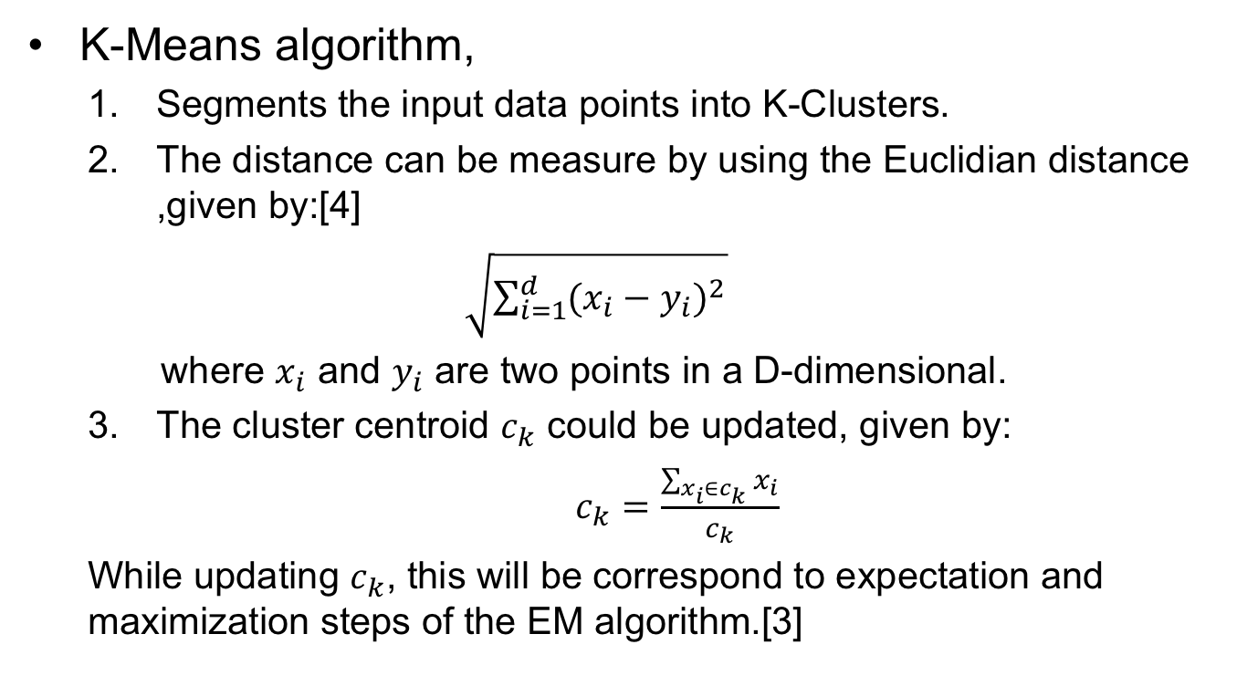
Methodology of recognition
K-Means algorithm,
Segments the input data points into K-Clusters.
The distance can be measure by using the Euclidian distance ,given by:[4]
$\sqrt{\sum_{i=1}^{d}{{(x_{i}−y_{i})}^{2}}}$
where $x_{i}$ and $y_{i}$ are two points in a D-dimensional.
The cluster centroid $c_{k}$ could be updated, given by:
$c_{k}=\frac{\sum_{x_{i}∈c_{k}}{x_{i}}}{c_{k}}$
While updating $c_{k}$, this will be correspond to expectation and maximization steps of the EM algorithm.[3]
Notes:
Explain K-Means in detail! Show an example (picture) for the other students to understand it easily.

Slide 17
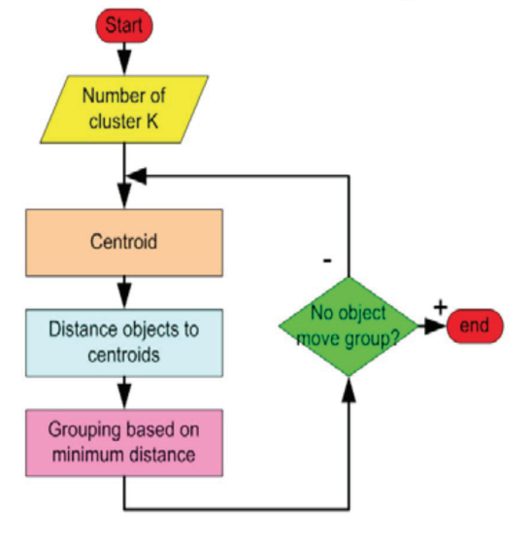
Methodology of recognition
The K-Means algorithm has the following producer steps:[5]
Fig. 5 Flow Chart of K-Means steps [5]
Notes:
Structure of K-Means is not clear:
- Idea of k-means
How does it work? – step by step
Differences between k-means and GMM

Slide 18
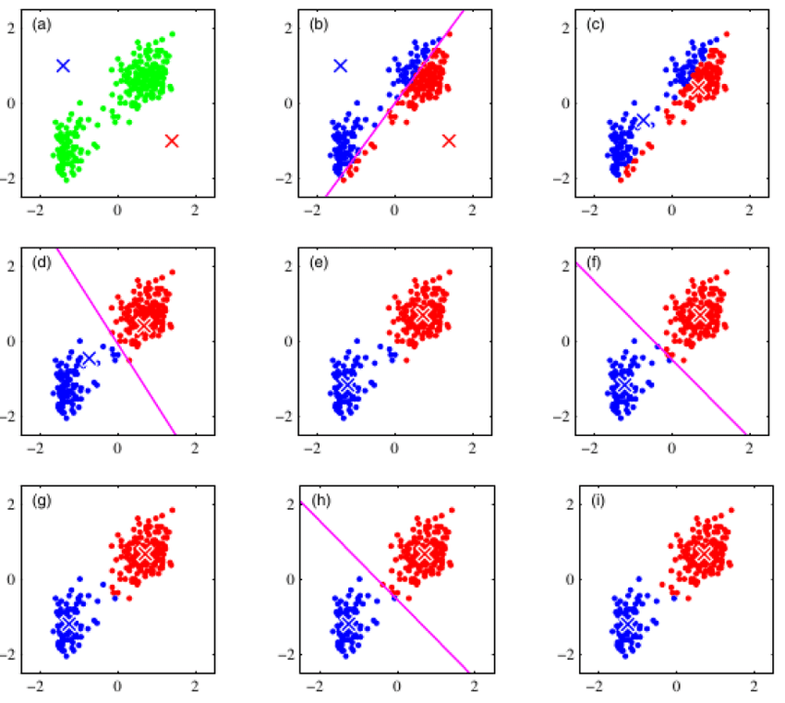
Methodology of recognition
Fig. 5 Illustration of K-Means algorithm[3]
Notes:
Structure of K-Means is not clear:
- Idea of k-means
How does it work? – step by step
Differences between k-means and GMM

Slide 19
Methodology of recognition
As difference of two algorithms,
GMM algorithm is soft assigns a point to clusters.
K-Means algorithm defines as hard assign a data point to one cluster.
GMM can make an elliptic shape cluster.
K-Means can only detect the spherical cluster.

Slide 20
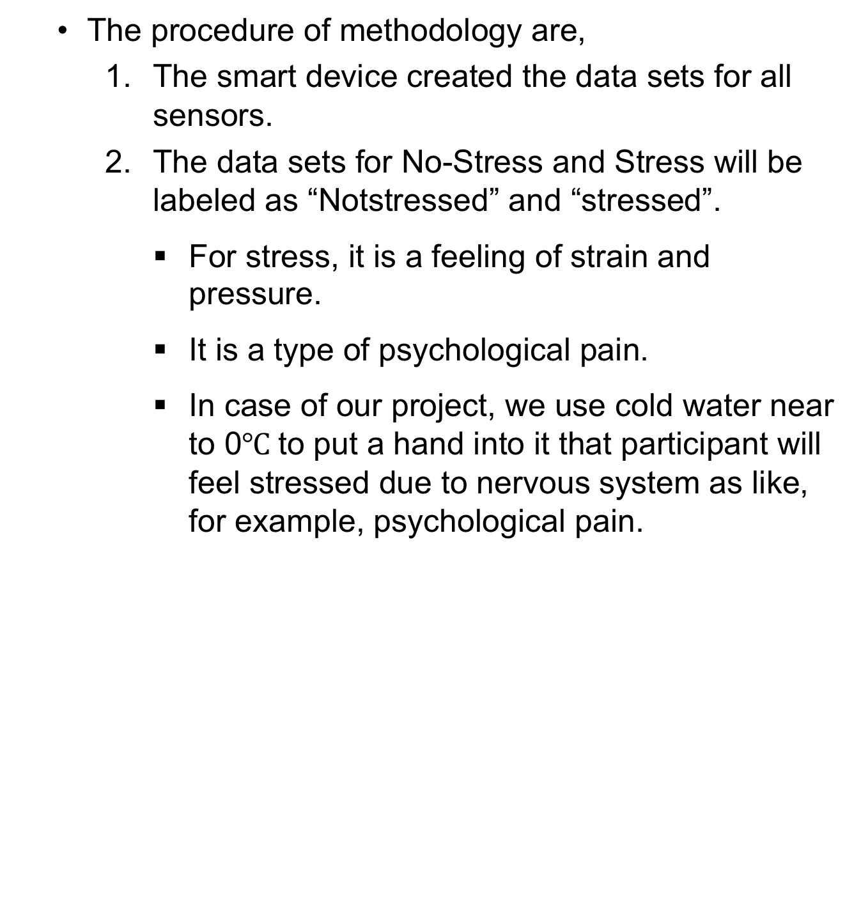
Methodology of recognition
The procedure of methodology are,
The smart device created the data sets for all sensors.
The data sets for No-Stress and Stress will be labeled as “Notstressed” and “stressed”.
For stress, it is a feeling of strain and pressure.
It is a type of psychological pain.
In case of our project, we use cold water near to 0$℃$to put a hand into it that participant will feel stressed due to nervous system as like, for example, psychological pain.
Notes:
Explain stress. What is stress? Where does this definition comes from?
You need to explain “smart device” and give an overview of all sensors.
Do you really first use k-means and then fit GMM on the data?

Slide 21
Methodology of recognition
3. Accelerometer is excluded in our procedure.
4. Fitting the data in a shape of distribution by GMM algorithm.
5. By using K-Means algorithm, the data sets result centroid and error in percentage.
Notes:
Explain stress. What is stress? Where does this definition comes from?
You need to explain “smart device” and give an overview of all sensors.
Do you really first use k-means and then fit GMM on the data?

Slide 22
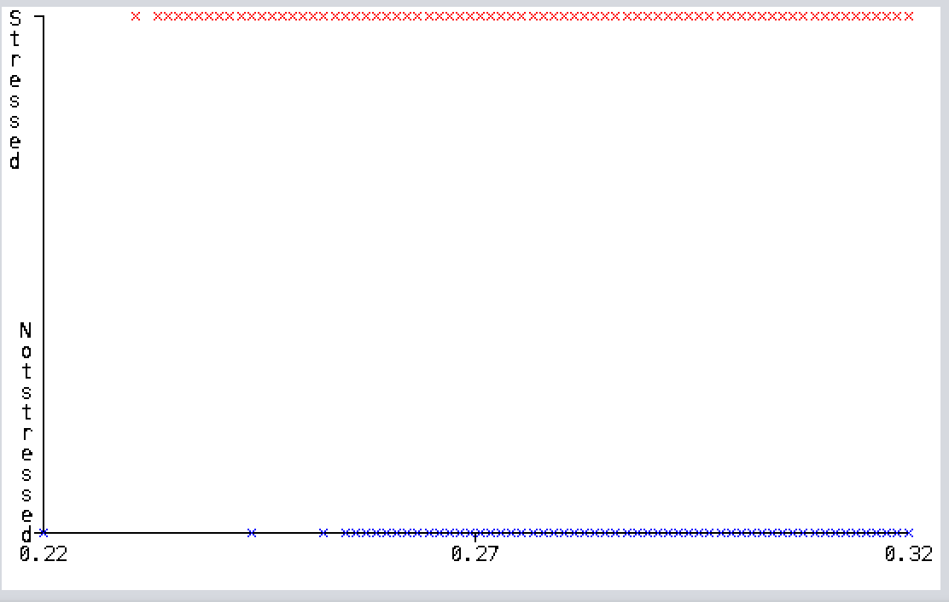
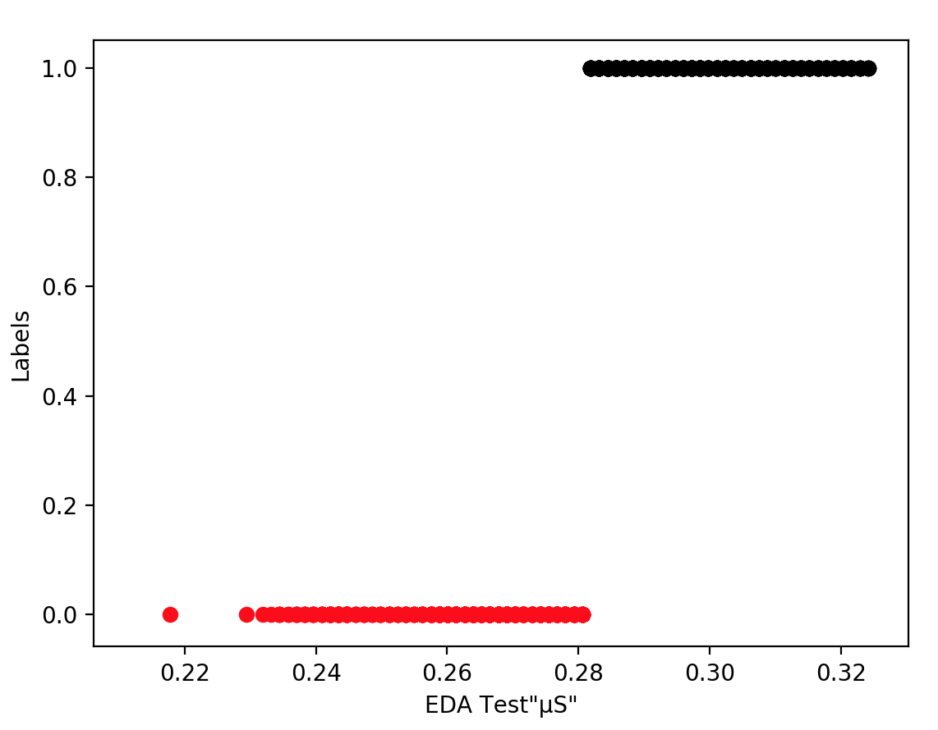
Evaluation of recognition
Weka
Python
Fig. 6 GMM EDA result on Weka and Python.
The Weka shows all data sets for two different clusters, but Python just making a boundary between two cluster with red for initial and black for stress to avoid overlapping.
Notes:
Axis – units missing
Legend missing

Slide 23
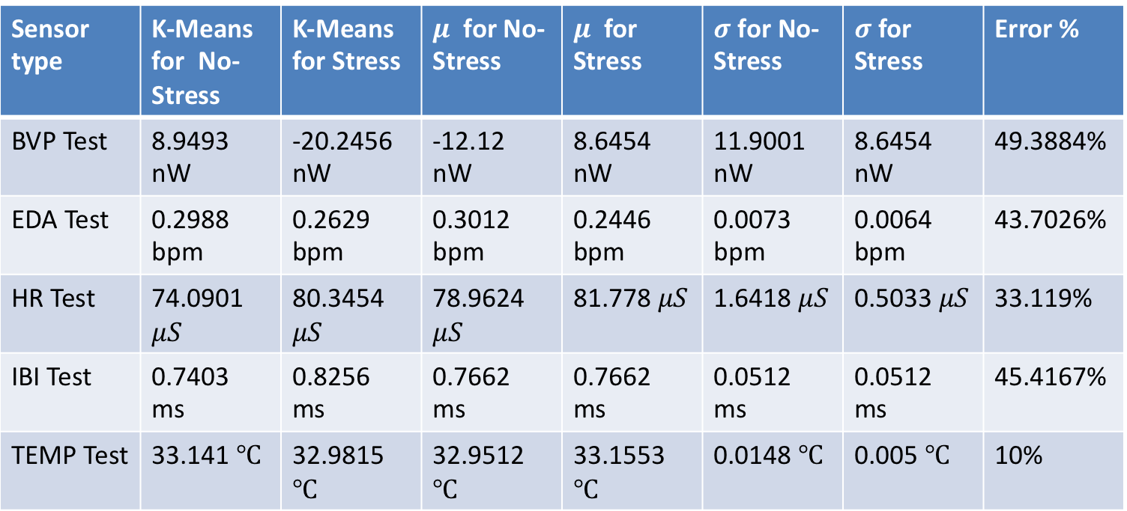
Test of recognition
Sensor type | K-Means for No-Stress | K-Means for Stress | $μ$ for No-Stress | $μ$ for Stress | $σ$ for No-Stress | $σ$ for Stress | Error %
BVP Test | 8.9493 nW | -20.2456 nW | -12.12 nW | 8.6454 nW | 11.9001 nW | 8.6454 nW | 49.3884%
EDA Test | 0.2988 bpm | 0.2629 bpm | 0.3012 bpm | 0.2446 bpm | 0.0073 bpm | 0.0064 bpm | 43.7026%
HR Test | 74.0901 $μS$ | 80.3454 $μS$ | 78.9624 $μS$ | 81.778 $μS$ | 1.6418 $μS$ | 0.5033 $μS$ | 33.119%
IBI Test | 0.7403 ms | 0.8256 ms | 0.7662 ms | 0.7662 ms | 0.0512 ms | 0.0512 ms | 45.4167%
TEMP Test | 33.141 $℃$ | 32.9815 $℃$ | 32.9512 $℃$ | 33.1553 $℃$ | 0.0148 $℃$ | 0.005 $℃$ | 10%
Table. 1 K-Means and GMM results for test measurements.
Notes:
Why has $σ no unit?$
It‘s not the evaluation - change headline!

Slide 24
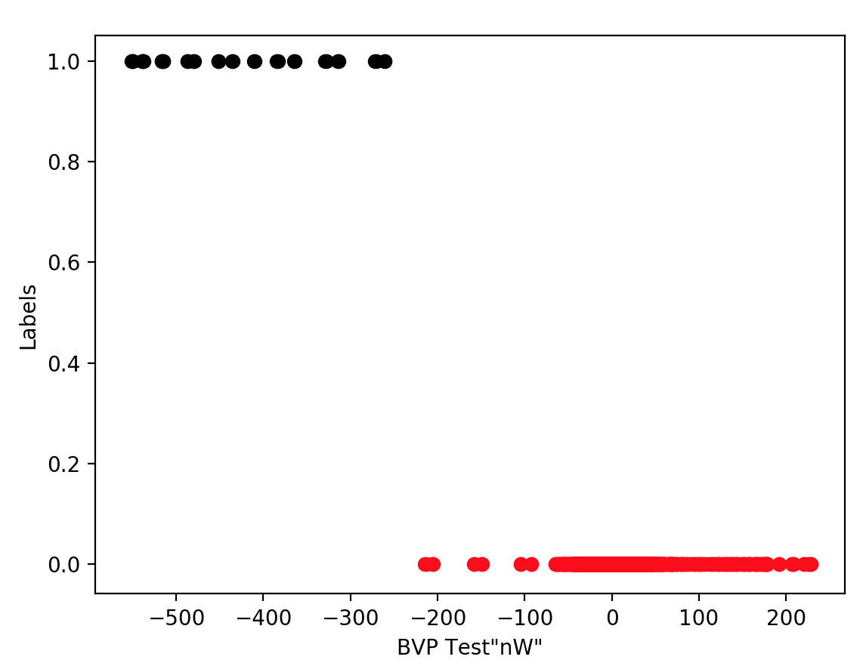
Evaluation of recognition
Fig. 3 GMM for BVP test
Notes:
Everywhere:
Axis – units missing
Legend missing

Slide 25
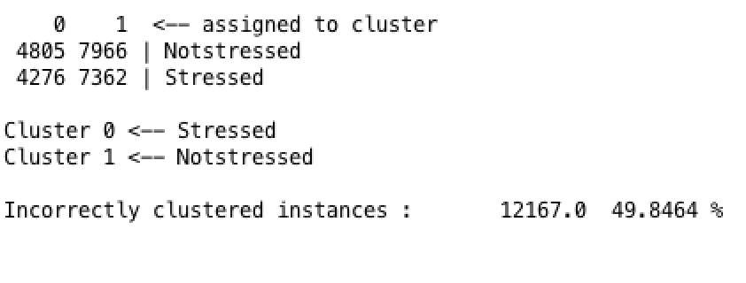
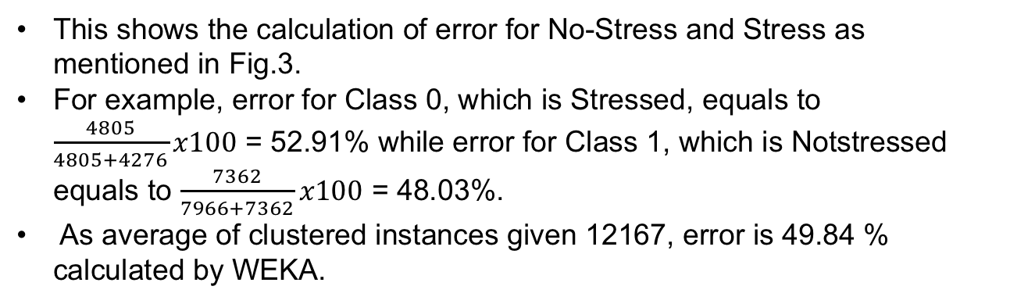
Evaluation of recognition
Fig. 3 Calculation error by using WEKA
This shows the calculation of error for No-Stress and Stress as mentioned in Fig.3.
For example, error for Class 0, which is Stressed, equals to $\frac{4805}{4805+4276}x100$ = 52.91% while error for Class 1, which is Notstressed equals to $\frac{7362}{7966+7362}x100$ = 48.03%.
As average of clustered instances given 12167, error is 49.84 % calculated by WEKA.
Notes:
Everywhere:
Axis – units missing
Legend missing

Slide 26
Evaluation of recognition
K-MEAN
Participant number | BVP Sensor |  |  | HR Sensor |  |  | Temp Sensor
 | K-Means for No-Stress [nW] | K-Means for Stress [nW] | Error [%] | K-Means for No-Stress [nW] | K-Means for Stress [nW] | Error [%] | K-Means for No-Stress [nW] | K-Means for Stress [nW] | Error %
P1 | 53.1 | -89.9 | 49.8 | 90.3 | 80.7 | 28.7 | 33.7 | 32.6 | 0
P2 | 26.2 | -47.5 | 46.9 | 87.5 | 71.8 | 19.1 | 34.1 | 33.5 | 0
P3 | -24.8 | 14.6 | 49.7 | 87.1 | 82.1 | 30.3 | 32.5 | 32.7 | 8.9
P4 | -26.6 | 13.6 | 47.7 | 80.5 | 90.1 | 44.1 | 31.9 | 32.1 | 22.8
Table 2. A comparison between stressed and not stressed in K-mean for three different sensors..
Notes:
What is this number of Stressed about? Is it the mean? You really need to tell us in your presentation!
BEFORE showing us the results: make a slide explaining how to claculate the error? What was the test data set and what was the training data set?

Slide 27
Evaluation of recognition
From table 2 we can see:
BVP sensor worst results and highest error.
Temp sensor best results and lowest error.
Participant number 2 has the best results.
Participant number 4 has the worst results.

Slide 28
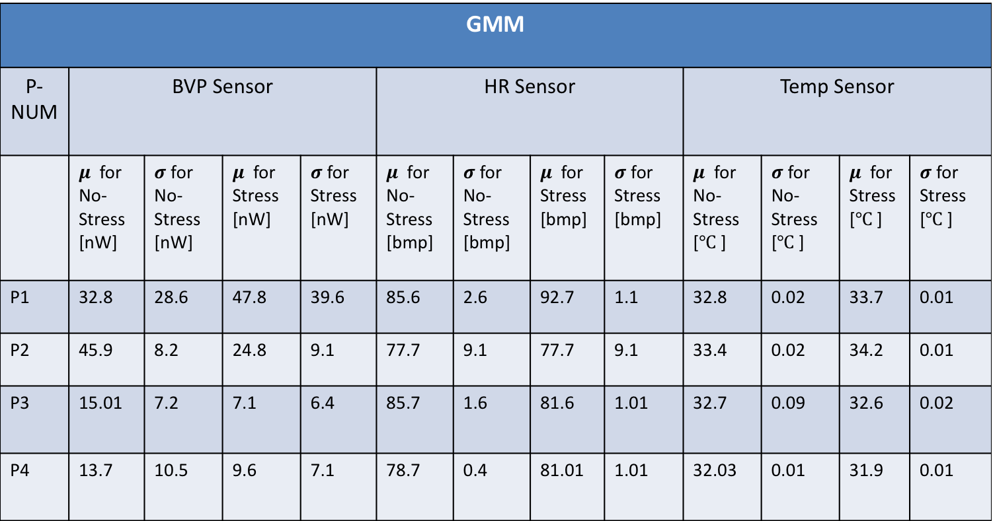
Evaluation of recognition
GMM
P-NUM | BVP Sensor |  |  |  | HR Sensor |  |  |  | Temp Sensor
 | $μ$ for No-Stress [nW] | $σ$ for No-Stress [nW] | $μ$ for Stress [nW] | $σ$ for Stress [nW] | $μ$ for No-Stress [bmp] | $σ$ for No-Stress [bmp] | $μ$ for Stress [bmp] | $σ$ for Stress [bmp] | $μ$ for No-Stress [$℃$ ] | $σ$ for No-Stress [$℃$ ] | $μ$ for Stress[$℃$ ] | $σ$ for Stress [$℃$ ]
P1 | 32.8 | 28.6 | 47.8 | 39.6 | 85.6 | 2.6 | 92.7 | 1.1 | 32.8 | 0.02 | 33.7 | 0.01
P2 | 45.9 | 8.2 | 24.8 | 9.1 | 77.7 | 9.1 | 77.7 | 9.1 | 33.4 | 0.02 | 34.2 | 0.01
P3 | 15.01 | 7.2 | 7.1 | 6.4 | 85.7 | 1.6 | 81.6 | 1.01 | 32.7 | 0.09 | 32.6 | 0.02
P4 | 13.7 | 10.5 | 9.6 | 7.1 | 78.7 | 0.4 | 81.01 | 1.01 | 32.03 | 0.01 | 31.9 | 0.01
Table 3. A comparison between stressed and not stressed in GMM for three different sensors.
Notes:
Highlight the main findings! -> everywhere!

Slide 29
Evaluation of recognition
From table 3 we can see:
Participant number 2 has the best results because there is not have any kind of overlapping in the two clusters of distribution.
Participant number 4 has the worst results because it has worst result with overlapping between its clusters.
Notes:
„no too much overlapping “ how much is that? Use numbers!

Slide 30
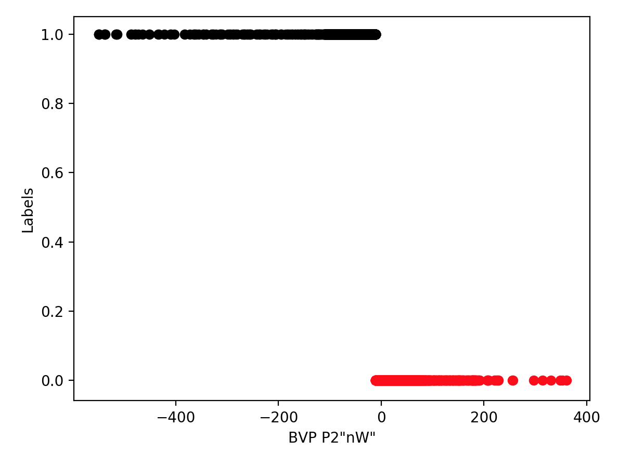
Evaluation of recognition
we can see overlapping problem in next figure:
Here with less overlapping for P2.
RED for Not Stressed and black for stressed.
FIG 7.
GMM for BVP
P2
Notes:
Fig 3 too small

Slide 31
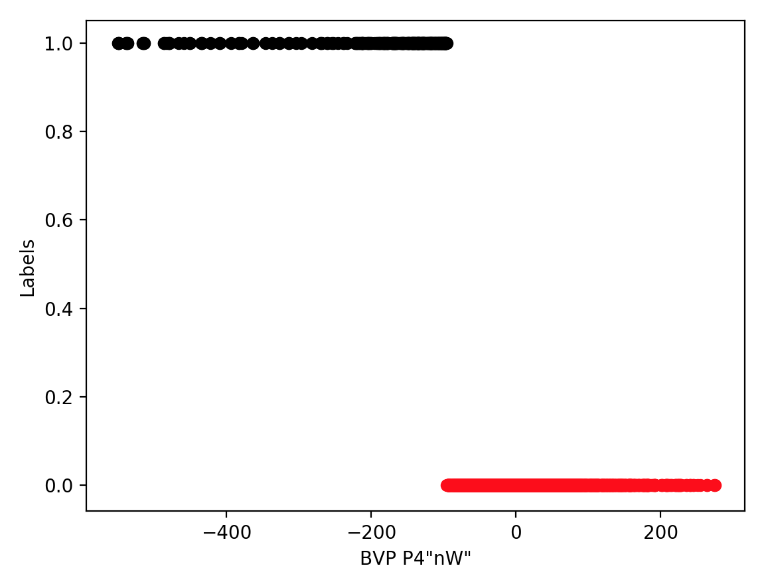
Evaluation of recognition
we can see overlapping problem in next figure:
Here with High overlapping for P4.
RED for Not Stressed and black for stressed.
FIG 8.
GMM for BVP
P4
Notes:
Same as fig 4

Slide 32
Conclusion
The conclusions based on GMM and K-Means algorithm for case stress and no stress then goal of this is comparison of participant with best result and worst result.
we have evaluated the result of different participants with best result with three sensors, which are BVP, Hear Rate and Temp, that have chosen.
As participant number 2, the result is tested with very good accuracy while the participant number 4 does not give us a good accuracy.
Notes:
Conclusion slide missing!
Reference slide missing!

Slide 33
References
Understanding Anxiety Guide, From: https://www.anxietyuk.org.uk/anxiety-type/stress/
Scikit Learn, “GMM Coveriances”, From: https://scikit-learn.org/stable/auto_examples/mixture/plot_gmm_covariances.html.
C.J.Bishop,“Pattern recognition and machine learning,””pp.22,111,424,430”, New York: Springer-Verlag, 2009.
S.Banerjee, A.Choudhary,S.Pal, “Empirical Evaluation of K-Means, Bisecting K-Means, Fuzzy K-Means and Genetic K-Means Clustering Algorithms”, “PP. 169”, IEEE International WIE Conference,2015.
Notes:
Conclusion slide missing!
Reference slide missing!

Slide 34
S.Kapil, M.Chawla, M.Dilshad, “On K-Means Data Clustering Algorithm with Genetiv Algorithm ”, “PP. 202”,Fourth International Conference on Paralle,2016.
F.Yi, I.Moon, “Extended K-Means Algorithm”, “PP. 263”,Fifth International Conference on Intelligent Human-Machine Systems and Cybernetics,2013.
E4 Empatica wristband,From: https://www.empatica.com/research/e4/
Notes:
Conclusion slide missing!
Reference slide missing!

Slide 35

Notes:
Conclusion slide missing!
Reference slide missing!

